Slide 1
Cryptographic Hash Functions
Lecture 7: Hashing
Notes:
Lecture slides by Lawrie Brown for “Cryptography and Network Security”, 5/e, by William Stallings, Chapter 11 – “Cryptographic Hash Functions”.

Slide 2
Data integrity

Slide 3
Hash Functions
Used to ensure integrity of data
condenses arbitrary message to fixed size
h = H(M)
usually assume hash function is public
hash used to detect changes to message
A cryptographic hash function must be:
computationally infeasible to find data mapping to specific hash (one-way property)
computationally infeasible to find two data to same hash (collision-free property)
Notes:
A hash function H accepts a variable-length block of data M as input and produces a fixed-size hash value h = H(M). A "good" hash function has the property that the results of applying the function to a large set of inputs will produce outputs that are evenly distributed, and apparently random. In general terms, the principal object of a hash function is data integrity. A change to any bit or bits in M results, with high probability, in a change to the hash code. The kind of hash function needed for security applications is referred to as a cryptographic hash function. A cryptographic hash function is an algorithm for which it is computationally infeasible (because no attack is significantly more efficient than brute force) to find either (a) a data object that maps to a pre-specified hash result (the one-way property) or (b) two data objects that map to the same hash result (the collision-free property). Because of these characteristics, hash functions are often used to determine whether or not data has changed.

Slide 4
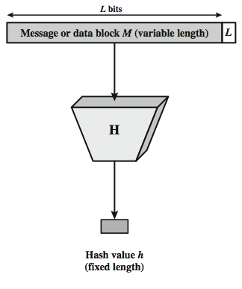
Cryptographic Hash Function
Notes:
Stallings Figure 11.1 depicts the general operation of a cryptographic hash function. Typically, the input is padded out to an integer multiple of some fixed length (e.g., 1024 bits) and the padding includes the value of the length of the original message in bits. The length field is a security measure to increase the difficulty for an attacker to produce an alternative message with the same hash value.

Slide 5
Other Hash Function Uses
to create a one-way password file
store hash of password not actual password
for intrusion detection and virus detection
keep & check hash of files on system
pseudorandom function (PRF) or pseudorandom number generator (PRNG)
Notes:
Hash functions are commonly used to create a one-way password file. Chapter 20 explains a scheme in which a hash of a password is stored by an operating system rather than the password itself. Thus, the actual password is not retrievable by a hacker who gains access to the password file. In simple terms, when a user enters a password, the hash of that password is compared to the stored hash value for verification. This approach to password protection is used by most operating systems.
Hash functions can be used for intrusion detection and virus detection. Store H(F) for each file on a system and secure the hash values (e.g., on a CD-R that is kept secure). One can later determine if a file has been modified by recomputing H(F). An intruder would need to change F without changing H(F).
A cryptographic hash function can be used to construct a pseudorandom function (PRF) or a pseudorandom number generator (PRNG). A common application for a hash-based PRF is for the generation of symmetric keys. We discuss this application in Chapter 12.

Slide 6
Two Simple Insecure Hash Functions
consider two simple insecure hash functions
bit-by-bit exclusive-OR (XOR) of every block
C_{i} = b_{i1} xor b_{i2} xor . . . xor b_{im}
a longitudinal redundancy check
reasonably effective as data integrity check
one-bit circular shift on hash value
for each successive n-bit block
rotate current hash value to left by1bit and XOR block
good for data integrity but useless for security
Notes:
To get some feel for the security considerations involved in cryptographic hash functions, we present two simple, insecure hash functions in this section. One of the simplest hash functions is the bit-by-bit exclusive-OR (XOR) of every block, which can be expressed as shown. This operation produces a simple parity for each bit position and is known as a longitudinal redundancy check. It is reasonably effective for random data as a data integrity check. Each n-bit hash value is equally likely. Thus, the probability that a data error will result in an unchanged hash value is 2^{–n}. With more predictably formatted data, the function is less effective. For example, in most normal text files, the high-order bit of each octet is always zero. So if a 128-bit hash value is used, instead of an effectiveness of 2^{–128}, the hash function on this type of data has an effectiveness of 2^{–112}.
A simple way to improve matters is to perform a one-bit circular shift, or rotation, on the hash value after each block is processed. Although this second procedure provides a good measure of data integrity, it is virtually useless for data security when an encrypted hash code is used with a plaintext message. Given a message, it is an easy matter to produce a new message that yields that hash code: Simply prepare the desired alternate message and then append an n-bit block that forces the new message plus block to yield the desired hash code.

Slide 7
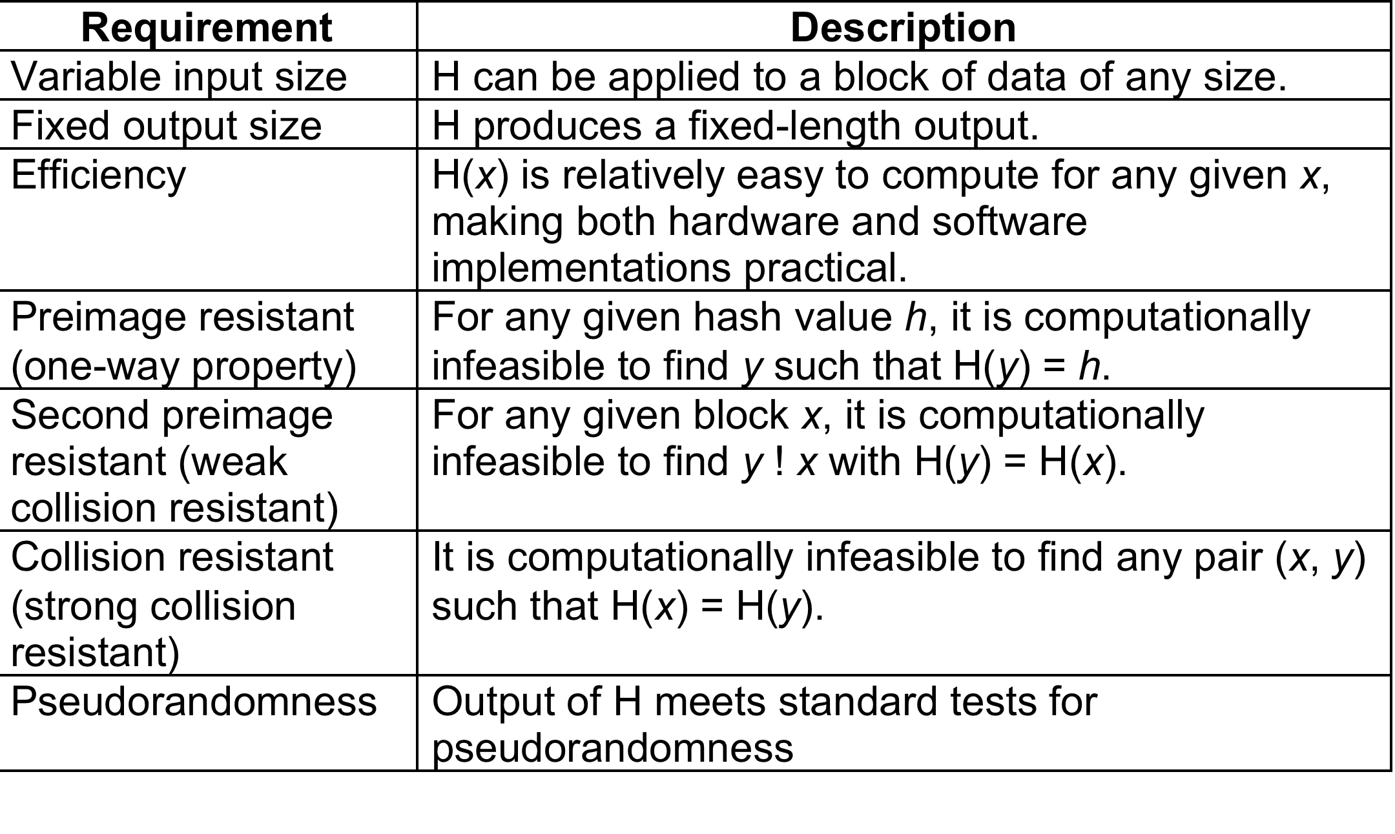
Hash Function Requirements
Notes:
Stallings Table 11.1 lists the generally accepted requirements for a cryptographic hash function. The first three properties are requirements for the practical application of a hash function. The fourth property, preimage (for a hash value h = H(x), we say that x is the preimage of h) resistant, is the one-way property: it is easy to generate a code given a message, but virtually impossible to generate a message given a code. This property is important if the authentication technique involves the use of a secret value (Figure 11.2c). The fifth property, second preimage resistant, guarantees that it is impossible to find an alternative message with the same hash value as a given message. This prevents forgery when an encrypted hash code is used (Figure 11.2b and Figure 11.3a). A hash function that satisfies the first five properties in Table 11.1 is referred to as a weak hash function. If the sixth property, collision resistant, is also satisfied, then it is referred to as a strong hash function. A strong hash function protects against an attack in which one party generates a message for another party to sign. The final requirement, pseudorandomness, has not traditionally been listed as a requirement of cryptographic hash functions, but is more or less implied.

Slide 8
Secure Hash Algorithm
SHA originally designed by NIST & NSA in 1993
was revised in 1995 as SHA-1
US standard for use with DSA signature scheme
standard is FIPS 180-1 1995, also Internet RFC3174
the algorithm is SHA, the standard is SHS
based on design of MD4 with key differences
produces 160-bit hash values
recent 2005 results on security of SHA-1 have raised concerns on its use in future applications
Notes:
In recent years, the most widely used hash function has been the Secure Hash Algorithm (SHA). The Secure Hash Algorithm (SHA) was developed by the National Institute of Standards and Technology (NIST) and published as a federal information processing standard (FIPS 180) in 1993; a revised version was issued as FIPS 180-1 in 1995 and is generally referred to as SHA-1. The actual standards document is entitled Secure Hash Standard. SHA is based on the hash function MD4 and its design closely models MD4. SHA-1 produces a hash value of 160 bits. In 2005, a research team described an attack in which two separate messages could be found that deliver the same SHA-1 hash using 2^69 operations, far fewer than the 2^80 operations previously thought needed to find a collision with an SHA-1 hash [WANG05]. This result has hastened the transition to newer, longer versions of SHA.

Slide 9
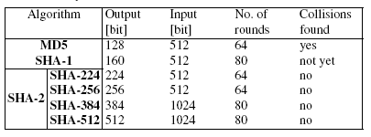

Slide 10
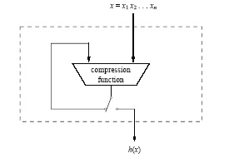
Merkle–Damgard hash function construction

Slide 11
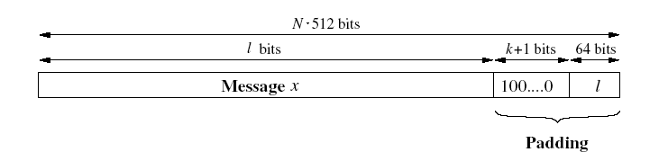
SHA-1

Slide 12
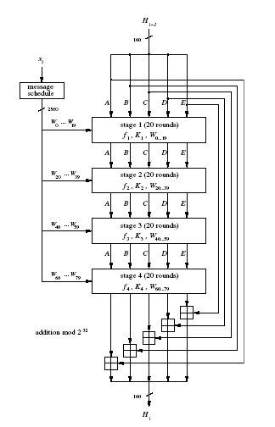
SHA-1

Slide 13
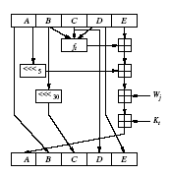
SHA-1

Slide 14

SHA-1

Slide 15
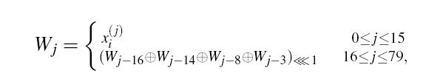
SHA-1

Slide 16
Revised Secure Hash Standard
NIST issued revision FIPS 180-2 in 2002
adds 3 additional versions of SHA
SHA-256, SHA-384, SHA-512
designed for compatibility with increased security provided by the AES cipher
structure & detail is similar to SHA-1
hence analysis should be similar
but security levels are rather higher
Notes:
In 2002, NIST produced a revised version of the standard, FIPS 180-2, that defined three new versions of SHA, with hash value lengths of 256, 384, and 512 bits, known as SHA-256, SHA-384, and SHA-512. Collectively, these hash algorithms are known as SHA-2. These new versions have the same underlying structure and use the same types of modular arithmetic and logical binary operations as SHA-1, hence analyses should be similar. A revised document was issued as FIP PUB 180-3 in 2008, which added a 224-bit version. SHA-2 is also specified in RFC 4634, which essentially duplicates the material in FIPS 180-3, but adds a C code implementation.
In 2005, NIST announced the intention to phase out approval of SHA-1 and move to a reliance on the other SHA versions by 2010.

Slide 17
SHA Versions
 | SHA-1 | SHA-224 | SHA-256 | SHA-384 | SHA-512
Message digest size | 160 | 224 | 256 | 384 | 512
Message size | < 2⁶⁴ | < 2⁶⁴ | < 2⁶⁴ | < 2¹²⁸ | < 2¹²⁸
Block size | 512 | 512 | 512 | 1024 | 1024
Word size | 32 | 32 | 32 | 64 | 64
Number of steps | 80 | 64 | 64 | 80 | 80
Notes:
Stallings Table 11.3 provides a comparison of the various parameters for the SHA hash functions.

Slide 18
References
Chapter No. 11 “Understanding Cryptography” by Christof Paar and Jan Pelzl
Chapter No. 11 “Cryptography and Network Security” by William Stallings

